Slide 1
International Trade and Foreign Exchange Rate

Slide 2
What is International Trade?
International trade is the exchange of goods and services between countries.
Trading globally gives consumers and countries the opportunity to be exposed to goods and services not available in their own countries.
Services are also traded: Tourism, banking, consulting and transportation.
If there is a trade of goods and services, then there will be a money flow.
Notes:
Trade is the exchange of goods between individuals, states, and countries. International trade refers to trading between two countries that takes place by water, air, or land. Local trade takes place in cities, towns, and villages, while state trade occurs between two or more states.
Without international trade, no country can live. It is made up of two parts: export and import. The difference between a country’s export and import is its trade balance. It is favorable when exports exceed imports; otherwise, it is unfavorable. India has trade links with all of the main trading blocs as well as all of the world’s geographical areas. Gems and jewelry, chemicals and associated products, agriculture and allied products, and other items are among the items exported from India to other countries.
Petroleum crude and products, gems and jewelry, chemicals and associated products, basic metals, electrical items, machinery, agriculture, and allied products are among the commodities imported into India. India has risen to prominence as a global software powerhouse, generating significant foreign exchange through information technology exports.

Slide 3
Benefits of International Trade
Increased Economic Efficiency
Access to a Wider Range of goods and services
Economic growth and development
Competition and Innovation
Notes:
Increased Economic Efficiency: Countries can specialize in producing goods and services where they have a comparative advantage, meaning they can produce at a lower opportunity cost. This leads to increased efficiency in resource allocation and higher overall production.
Access to a Wider Range of Goods and Services: Through trade, countries can access goods and services that they cannot produce domestically or can only produce at a higher cost. This widens consumer choices and can lead to better quality and lower prices for consumers.
Economic Growth and Development: International trade can stimulate economic growth by providing opportunities for businesses to expand into new markets, leading to increased production, investment, and employment. Developing countries can also benefit from trade by exporting their goods and earning foreign exchange, which can be used for investment in infrastructure and social development.
Competition and Innovation: Trade exposes domestic industries to competition from foreign producers, which can drive innovation, efficiency improvements, and technological advancements. This can lead to higher productivity and competitiveness in both domestic and international markets.
Example: Let's consider the case of Japan, a country with limited natural resources. Japan relies heavily on international trade to meet its energy needs, as it lacks significant domestic energy sources. Through trade, Japan imports oil and natural gas from countries like Saudi Arabia and Australia. This allows Japan to sustain its industrial and economic activities without being hindered by resource constraints.
Additionally, Japan is known for its automotive industry. By engaging in international trade, Japanese automakers export vehicles to markets around the world. This not only brings revenue into the country but also encourages innovation and efficiency improvements within the industry to remain competitive in the global market.
Overall, international trade plays a crucial role in supporting Japan's economic growth, ensuring access to essential resources, and promoting innovation in key industries.
Reasons for International Trade
The reasons for international trade would include the following points:
Production- It is not possible for every country to produce at an equal cost and because of this international trade takes place.
Factors of Production- It includes labor, capital as well as raw materials for the production of goods that are available at various levels in different countries.
Cost of Production- Countries prefer those countries in which production can take place at a lower cost.
Resource Distribution- There is always the limitation of resource distribution and there is unequal distribution of resources in the country. Examples include jute products of Bengal, food products from Punjab, Kerala for spices, and so forth.
Outcomes of International Trade
The outcome of international trade would include-
International trade between two or more countries assists all of them in making the most use of their natural resources. Every country can concentrate on producing goods and services from these resources and selling them to other countries in order to gain foreign cash and strengthen their economy.
It enables a country to receive commodities and services that it would be unable to produce on its own due to a lack of resources or greater production costs. They may obtain these things at a reduced cost from outside the country.
Some countries have advantages such as natural resources, labor, technology, and capital. These resources enable them to produce specific types of goods and services at lower costs and sell them to other countries that require them.
It aids in smoothing out the advantages and putting a halt to the wild oscillations that can occur as a result of these items’ unavailability.

Slide 4
Theories of International Trade
Absolute Advantage Theory
Exports those goods and services for which a country is more productive than other countries.
Import those goods and services for which other countries are more productive than it is.
Country should concentrate on production of goods in which it holds absolute advantage.
Notes:
The theory of absolute advantage was put forward by Adam Smith who argued that different countries enjoyed absolute advantage in the production of some goods which formed the basis of trade between the countries.

Slide 5
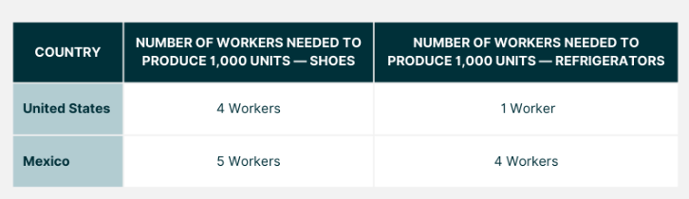
Example
Notes:
Comparative advantage looks at the reduction of opportunity cost, which is the potential benefit gained by choosing to produce more of one product instead of producing the maximum amount of both products a country has absolute advantage in.
In the table, we see the United States has the absolute advantage in both refrigerators and shoes.
Absolute advantage examines the productivity of workers in each country, answering the question "how many inputs are needed to produce shoes in Mexico?"

Slide 6
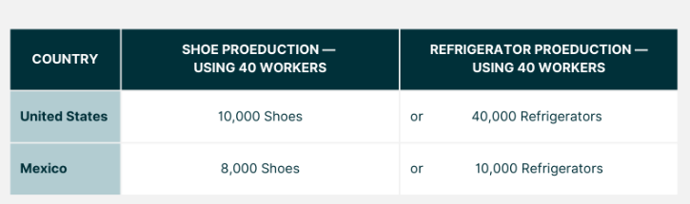
Theory of Comparative Advantage
Notes:
Comparative advantage asks the question in a different way, instead focusing on the output it takes to produce goods in a country.
It identifies the good where the absolute advantage is relatively larger, or where the productivity disadvantage is smaller.
Comparative Advantages help countries consider possibilities for trade, and how to maximize production for profit.
In this situation, the United States has a higher comparative advantage of shoes over refrigerators (1 worker in the US versus 4 in Mexico), and Mexico has a higher comparative advantage of shoes (5 workers in Mexico versus 4 in the US).
If both countries were to continue with their production rates, using 40 workers per good, the United States would produce 10,000 shoes and 40,000 refrigerators.
Mexico would produce 8,000 shoes, and 10,000 refrigerators, shown in the chart below.
If point A on each graph which is where countries start producing and consuming before trade. At this point, the United States produces 20,000 refrigerators and 5,000 pairs of shoes.
Mexico produces 4,000 pairs of shoes and 5,000 refrigerators, for a total of 9,000 shoes produced, and 25,000 refrigerators produced.
If each country were to transfer workers toward their area of comparative advantage, this would shift slightly.
If the US transferred six workers away from shoes to work on refrigerators, the shoe production decreases by 1,500 units (6/4 x 1,000), and refrigerator production increases by 6,000 (6/1 x 1,000).
If Mexico moves toward their area of comparative advantage, and transfers 10 workers to work on production of shoes, the production of refrigerators decreases by 2,500 (10/4 x 1,000), and production of shoes increases by 2,000 pairs (10/5 x 1,000).
This leads to a greater production of goods overall, as shown in the chart below.

Slide 7
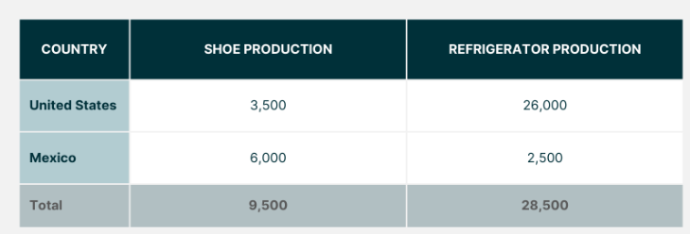
Trade leading to increase in Overall Production
Notes:
This example shows that even though the United States has an absolute advantage in both goods, both countries can benefit from increased production in their area of comparative advantage. The United States will then export refrigerators, and import shoes.

Slide 8
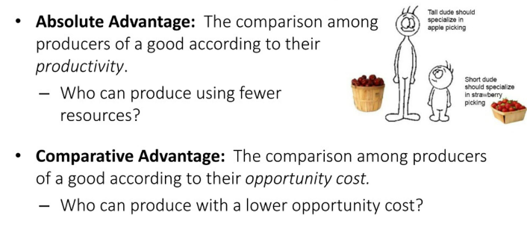
Summary

Slide 9
Heckscher-Ohlin Model of International Trade
Ricardo’s theory suggests that comparative advantage arises from differences in productivity.
Eli Heckscher and Bertil Ohlin argued that comparative advantage arises from differences in national factor endowment – the extent to which a country is endowed with resources like land, labour and capital.
The theory predicts that the countries will exports goods that make intensive use of those factors that are locally abundant, while importing goods that make intensive use of factors that are locally scarce.
Notes:
The Heckscher-Ohlin theory, developed by Swedish economists Eli Heckscher and Bertil Ohlin in the early 20th century, came into the picture to explain why countries engage in international trade and the patterns of trade they observe. This theory builds upon the concept of comparative advantage, initially proposed by David Ricardo, but introduces the role of factor endowments, such as land, labor, and capital, in determining comparative advantage and trade patterns.
The Heckscher-Ohlin theory states that countries will export goods that intensively use the factors of production they have in abundance, and import goods that intensively use factors they have in relatively scarce supply. In simpler terms, countries will specialize in producing goods that make the most efficient use of their available resources.
For example, if a country has abundant labor but limited capital, it will tend to specialize in and export labor-intensive goods and import capital-intensive goods. Conversely, a country abundant in capital but scarce in labor will specialize in and export capital-intensive goods while importing labor-intensive goods.
The theory suggests that differences in factor endowments across countries drive international trade, as countries seek to maximize their production efficiency and welfare by specializing in the production of goods that utilize their abundant factors of production.
The Heckscher-Ohlin theory, also known as the factor-proportions theory, explains international trade patterns based on the differences in the relative abundance of factors of production, particularly labor and capital, between countries. Here's a simple explanation with an example:
Imagine two countries, Country A and Country B. Country A has an abundance of capital (machinery, technology, etc.), while Country B has an abundance of labor (workers).
According to the Heckscher-Ohlin theory:
Factor Abundance: Country A has more capital per worker, and Country B has more labor per unit of capital.
Production Differences: Because of their factor endowments, Country A is more likely to specialize in producing capital-intensive goods (goods that require a lot of machinery and technology), while Country B is more likely to specialize in producing labor-intensive goods (goods that require a lot of human labor).
Trade Patterns: Country A will export capital-intensive goods and import labor-intensive goods, while Country B will export labor-intensive goods and import capital-intensive goods.
For example:
Let's say Country A has advanced technology and a lot of machinery. They can produce cars efficiently because cars require a lot of machinery (capital) to manufacture.
On the other hand, Country B has a large population of skilled and unskilled workers. They can produce garments efficiently because making clothes requires a lot of labor.
According to the Heckscher-Ohlin theory, Country A will specialize in producing cars and export them to Country B, while Country B will specialize in producing garments and export them to Country A. This specialization and trade are based on each country's factor endowments—Country A's abundance of capital and Country B's abundance of labor.
The Heckscher-Ohlin theory and the comparative advantage theory are related but offer different perspectives on why countries engage in international trade and how trade patterns emerge.
Basis of Analysis:
Comparative Advantage Theory: This theory, developed by David Ricardo, focuses on differences in opportunity costs of production between countries. It suggests that countries should specialize in producing goods in which they have a comparative advantage (i.e., the lowest opportunity cost of production) and trade with other countries to obtain goods in which they do not have a comparative advantage.
Heckscher-Ohlin Theory: In contrast, the Heckscher-Ohlin theory focuses on differences in factor endowments (such as land, labor, and capital) between countries. It suggests that countries will export goods that intensively use the factors of production they have in abundance and import goods that intensively use factors they have in relatively scarce supply.
Determinants of Trade Patterns:
Comparative Advantage Theory: Trade patterns are determined by differences in relative production costs (opportunity costs) between countries. Countries will specialize in and export goods in which they have a comparative advantage, leading to mutually beneficial trade.
Heckscher-Ohlin Theory: Trade patterns are determined by differences in factor endowments between countries. Countries will specialize in and export goods that make the most efficient use of their abundant factors of production, while importing goods that utilize factors they lack in abundance.
Focus on Factors of Production:
Comparative Advantage Theory: While factors of production (like labor and capital) are implicitly considered in the concept of comparative advantage, the theory does not explicitly analyze the role of factor endowments in driving trade patterns.
Heckscher-Ohlin Theory: This theory explicitly incorporates factor endowments as the key determinant of trade patterns. It emphasizes the role of differences in factor availability across countries in shaping comparative advantage and trade.
In summary, while both theories address why countries trade and how trade patterns emerge, the comparative advantage theory focuses on differences in relative production costs, while the Heckscher-Ohlin theory emphasizes differences in factor endowments as the primary driver of trade patterns.

Slide 10
Balance of Payment
The balance of payments (BOP) is the method countries use to monitor all international monetary transactions in a specific period.
All trades conducted by both the private and public sectors are accounted for in the BOP to determine how much money is going in and out of a country. If a country has received money, this is known as a credit, and if a country has paid or given money, the transaction is counted as a debit.
Theoretically, the BOP should be zero
Notes:
Usually, government records all the transactions that arise between a country and the outside world. This record is titled Balance of Payments. Balance of Payments can also be known as the Balance of International Payments. It is a statement of all transactions between entities in one country and the outside world over a specified time period, such as a quarter or a year. It lists all interactions between residents of one country and residents of other countries that involve businesses, organizations, or governments. Balance of Payments includes all the economic transactions, which involve the transfer of holding or title of goods, and services. Economic transactions include the activity that has a monetary effect, and also involves a transfer of the title or ownership of money, assets, goods, and services. These transactions can be made between individuals, firms, and the country’s government within a country and individuals, firms, and governments outside the country.
Now the question arises who is considered a Resident?
Residents of one country comprise individuals, business concerns, and several government organizations. Government agencies include several departments, like the Department of Agriculture, Defense, Education, and Commerce. However, resident of a country does not include tourists, workers that travel from one place to another (known as migratory workers), diplomatic staff, and foreign military personnel even if they reside in and work within the domestic boundary of a nation.

Slide 11
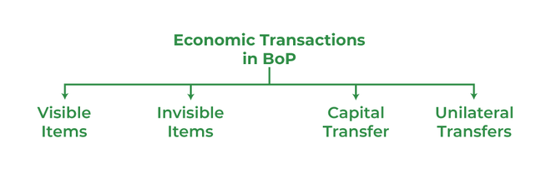
Economic Transaction in BoP
Economic transactions include the activity that has a monetary effect, and also involves a transfer of the title or ownership of money, assets, goods and services. These transactions can be made between individuals, firms, and the country’s government within a country and individuals, firms, and governments outside the country. It can be classified as follows:
Notes:
1. Visible: These include the export and import of all types of tangible goods. These are called ‘visible’, as they can be touched, seen, felt, and measured. The movement of visible items is open and is verifiable through customs officials.
2. Invisible: These include the export and import of services, like software services, insurance, shipping, banking, etc. These are called ‘invisible’, as they cannot be touched, seen, felt, or measured.
3. Capital Transfers: These include capital receipts and capital payments. Receipts that increase financial liabilities or decrease financial assets are known as capital receipts. For example, the sale of assets or borrowing. In both cases, there is an inflow of cash. Capital Payments comprise an outflow of cash. For example, the purchase of assets or repayment of the loan.
4. Unilateral Transfers: These are one-sided transactions that include the transfer of goods and services without any claims for repayment. For example, a child studying abroad sends gifts to her parents. It also considers grants and donations that one government sends to other foreign governments.
There is an inflow and outflow of foreign currency when international trade( export and import )take place. When a country, for example, India transfers goods and services to a foreign country, say, the USA, in exchange the foreign country transfers foreign currency, i.e., dollars to India. Thus, there is an inflow of foreign currency. Likewise, when the USA transfers goods and services to India, in exchange India makes payments in Dollars to the USA, which is an outflow of foreign currency. Inflow and Outflow can also take place in terms of investment. When a foreigner invests in our country whether in real or financial assets, it implies inflow, and when our residents invest in a foreign country whether in real or financial assets, it implies outflow of foreign currency. Thus, it can be concluded that BoP records all the monetary transactions that occur among the residents of a country and the outside world over time.
Characteristics of Balance of Payments
1. It is the aggregation of all the transactions whether it is visible or invisible.
2. It is prepared for a specific period, generally annually.
3. BoP is a comprehensive statement that encompasses visible, invisible, and capital transfers.

Slide 12
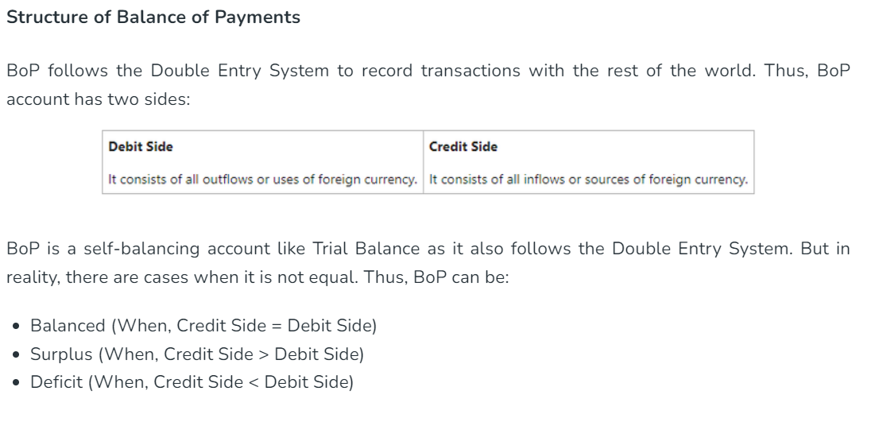

Slide 13
Components of Balance of Payment
1. Current Account
2. Capital Account
These two accounts are autonomous in nature.
3. Foreign Exchange Account (FOREX Account)
This account is accommodating in nature. The financial assets of the government held in the central bank are known as the Foreign Exchange Reserves. If there is a change in the reserves, it serves as the financing item in India’s BoP. Hence, any withdrawal from the reserves is recorded on the credit side of BoP, and any addition to these reserves is recorded on the debit side of BoP. Also, any change in the reserve is recorded in the BoP account and not in ‘Reserves’.
Notes:
A Forex (foreign exchange) account plays a significant role in the balance of payments (BoP) of a country, particularly concerning the capital and financial account components of the BoP. Here's how:
Capital Account Transactions: Forex accounts facilitate transactions related to capital flows, such as foreign direct investment (FDI), portfolio investment, and loans. These transactions involve the buying and selling of foreign currencies, assets, and securities. For instance, when a foreign investor purchases stocks or bonds denominated in the local currency, they need to exchange their foreign currency for the local currency, which impacts the Forex market.
Financial Account Transactions: The Forex market is the primary mechanism through which financial assets and liabilities denominated in foreign currencies are bought and sold. This includes transactions such as purchasing foreign stocks, bonds, or other financial instruments. These transactions directly affect the balance of payments by influencing the supply and demand for currencies, which in turn affects exchange rates.
Exchange Rate Impact: Fluctuations in exchange rates can influence the value of transactions recorded in the balance of payments. For example, if a country's currency depreciates against the currency in which its exports are denominated, the value of exports in the local currency increases, potentially improving the current account balance. Conversely, a depreciation can increase the cost of imports, worsening the current account balance.
Reserve Management: Central banks often use Forex accounts to manage their foreign exchange reserves. These reserves are held in various currencies and can be used to intervene in the foreign exchange market to stabilize exchange rates or to meet international payment obligations. Changes in a country's foreign exchange reserves are recorded in the balance of payments.
Overall, Forex accounts serve as a conduit for international financial transactions, affecting a country's balance of payments by influencing capital flows, exchange rates, and the composition of international reserves.

Slide 14
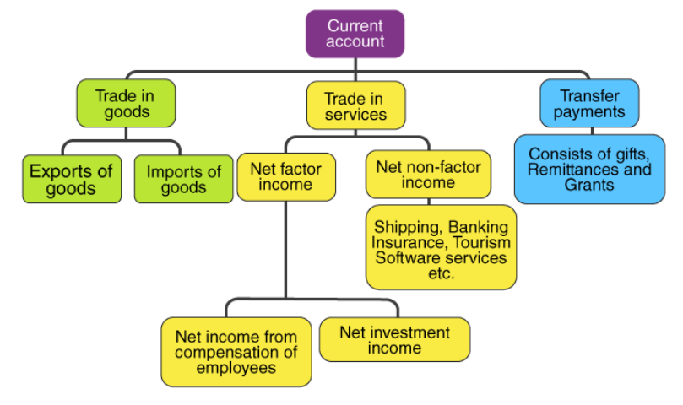
Current Account
Notes:
Current Account refers to the account, which records all the transactions that relate to the actual receipts and payments of the visible items, invisible items, and unilateral transfers during a specific period of time. It is a statement that records the trade of goods & services and current transfers during a specific period. In simple words, the current account focuses on the transactions related to tangible items(goods), intangible items( services), and one-sided transfers(gifts and grants).
Components of Current Account
It can be further categorized into:
1. Export and Import of Goods (Visible Trade or Merchandise Transactions)
Transactions in foreign trade mostly include the export and import of goods or visible items. Payment for the import of visible items or goods is recorded on the debit side and receipt from exports of visible items is recorded on the credit side of the Balance of Payment Account. The balance of the visible export and imports of goods is called Balance of Trade or Trade Balance.
2. Export and Import of Services (Invisible Trade)
It is also known as Invisible Trade because the services being intangible can not be spotted moving across the border. For example, insurance and banking. The balance of the invisible items (exports – imports) is known as the Balance of Invisible Trade. The payments of services are recorded on the debit side and receipts on the credit side of the Balance of Payment Account. Services can be categorized into three parts; viz., Banking, Insurance, and Shipping.
3. Unilateral or Unrequited Transfers to and from abroad (One-sided Transactions)
These transfers occur between a resident and a non-resident in the form of gifts, grants, and donations. It also includes official transfers, like grants in cash and donations. These are one-sided transactions and are commonly named transfers for free. These are payments and receipts that occur without receiving any in-kind services. It is generally considered as a part of ‘invisible’ in the BoP account. The receipt of unilateral transfers from the rest of the world is recorded on the credit side and payments on the debit side of BoP.
4. Income receipts and payments to and from abroad
It involves investment income in the form of rent, profits, and interest.

Slide 15
Review Question
Question: The components of a Balance of Payment account are
Capital account
Current account
Both a and b
None of the above
Notes:
c

Slide 16
Review Question
Question: Balance of Trade is the
Difference between exports and imports of services
Total of exports and imports of services
Difference between exports and imports of goods
Total of export and imports of goods
Notes:
What is Balance of Trade?
Balance of Trade refers to the difference between the Export and Import of Goods. Exports are listed on the credit side (positive items) and Imports are listed on the debit side (negative items).
Balance of Trade = Exports of Goods – Imports of Goods
Balance of Trade is just a part of the Balance of Payment but plays an important role in understanding the BoP of the country. It is also known as the Balance of Visible Trade and Trade Balance.
Balance on Balance of Trade
Generally, the Balance of Trade has balanced itself; but sometimes the value of exports is not equal to the value of imports. Therefore, the Balance of Trade (BoT) can be surplus (positive) or deficit (negative).
Surplus Balance of Trade (BoT): If the exports of goods of a country are more than its imports, then the Balance of Trade is said to be in surplus. It means that the balance of trade is favourable for the country.
Deficit Balance of Trade (BoT): If the imports of goods of a country are more than its exports, the Balance of Trade is said to be in deficit. It means that the balance of trade is unfavourable for the country.

Slide 17
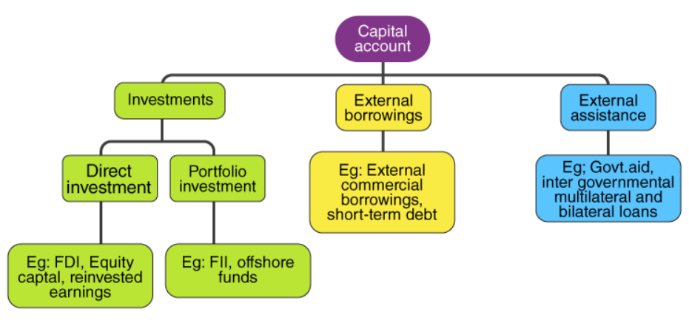
Capital Account
Notes:
Capital Account
It comprises all the transactions, which has a direct or indirect impact on the assets and liabilities of the country or government with regard to the outside world. Under this, transactions like loans and investments are recorded among a country and the outside world. Thus, it can be concluded that capital accounts cause potential claims. Sometimes, there is confusion regarding whether the export and import of capital goods are to be included in the Capital account or not. But the answer to this question is ‘No’. It is so because the export and import of goods (whether capital or consumer) are included in the current account. Thus, it is irrelevant in the case of the capital account. In simple terms, a capital account includes those transactions, which cause a change in the assets or liabilities of a country’s residents or its government.
Components of Capital Account
1. Borrowings and Lendings to and from abroad
The capital account consists of all the transactions related to borrowings from abroad by the government, private sector, etc. The receipts and repayments of such loans are recorded on the credit side of the BoP. Similarly, all the transactions related to ‘lending to abroad’ by the government and private sector are included in the capital account. These transactions are recorded on the debit side of the BoP.
2. Investments to and from abroad
The second component of the Capital Account consists of all the investments by the rest of the world in shares of Indian companies, real estate, etc. These transactions from the rest of the world are recorded on the credit side of BoP, as these transactions bring foreign exchange to the country. Besides, it also includes all the investments made by Indian residents in shares of foreign companies, real estate abroad, etc. These transactions are recorded on the debit side of the BoP, as they result in the outflow of foreign exchange.
There are two types of investments to and from abroad:
Foreign Direct Investment: FDI consists of the purchase of an asset, which gives direct control to the buyer over the asset. For example, purchase of land, building, etc.
Portfolio Investment: It consists of the purchase of an asset that does not give any direct control over the asset to the purchaser. For example, purchase of shares. Portfolio Investment also consists of FII (Foreign Institutional Investment).

Slide 18
Exchange Rate
The exchange rate is the value of one currency in terms of another currency. It represents how much of one currency is needed to purchase a unit of another currency.
Exchange rates are quoted in pairs, such as EUR/USD or GBP/JPY, where the first currency is the base currency and the second currency is the quote currency.
Notes:
What is Foreign Exchange?
Foreign exchange refers to foreign currency. For example, for an Indian resident Indian rupee(₹) is a domestic currency that can be used as a medium of exchange in India. But the Indian rupee (₹) can not be used as a medium of exchange outside India. The currency used in other countries is treated as foreign currency for India. Therefore, in the case of international transactions, the domestic currency is converted into foreign currency. For example, if a person visits New York for vacation, he/she can not use the Indian rupee (₹) in New York for economic transactions. The person has to convert the Indian rupee into US Dollars ($), only then he/she can stay there. For that reason, it is important to know at what price domestic currency can be converted into foreign currency. This price is known as the exchange rate. The market in which domestic currency is traded for others is the “Foreign Exchange Market”.
Foreign Exchange Rate:
“The rate at which the domestic currency can be exchanged for the foreign currency is known as Foreign Exchange Rate“.
The foreign exchange rate is the price paid in the domestic currency (₹) for buying a unit of foreign currency. It links the currencies of different countries and enables the comparison of international prices. For example, to buy a unit of $(dollar), if you have to pay ₹60, then the exchange rate is ₹60 per dollar. It can be written in the form; of $1=₹60.

Slide 19
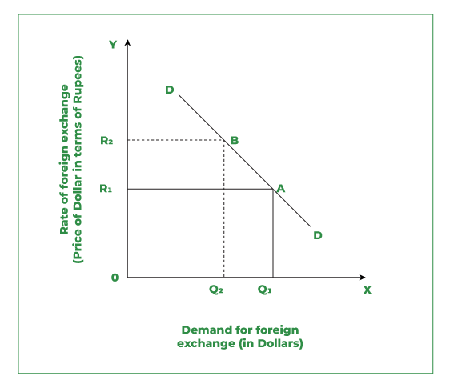
Demand of Foreign Exchange
Notes:
What is Foreign Exchange?
Foreign exchange refers to foreign currency. For example, for an Indian resident, the Indian rupee (₹) is a domestic currency that can be used as a medium of exchange in India. But the Indian rupee (₹) can not be used as a medium of exchange outside India. The currency used in other countries is treated as foreign currency for India. Therefore, in the case of international transactions, the domestic currency is converted into foreign currency. For example, if a person visits New York for vacation, he/she can not use the Indian rupee (₹) in New York for economic transactions. The person has to convert the Indian rupee into US Dollars ($), only then he/she can stay there. For that reason, it is important to know at what price domestic currency can be converted into foreign currency. This price is known as the Exchange Rate. The market in which domestic currency is traded for others is the “Foreign Exchange Market”.
Foreign Exchange Rate
“The rate at which the domestic currency can be exchanged for the foreign currency is known as Foreign Exchange Rate“. In simple terms, the foreign exchange rate is the price paid in the domestic currency (₹) for buying a unit of foreign currency. It links the currencies of different countries and enables the comparison of international prices. For example, to buy a unit of $(dollar), if you have to pay ₹60, then the exchange rate is ₹60 per dollar. It can be written in the form; of $1=₹60.
Demand for Foreign Exchange:
The demand for foreign exchange arises when a person has to make a payment in foreign currency. In simple terms, it indicates the outflow of foreign currency. It is demanded by Indian residents for the following reasons:
Import of Goods and Services: In the case of the Import of goods and services from a foreign country the payment is made by the importer (the person who imports goods and services) in foreign currency; thus, creating a demand for foreign exchange in India’s Foreign Exchange Market.
Unilateral Transfers Sent Abroad: These are the transfers made by the person for free. It includes the transfer of gifts and grants sent by the government or a person to other countries. These are called unilateral transfers because they are not made to get something in return and because of this reason, foreign exchange is required. For example, If a foreigner is working in India. It means that he is earning income in Indian Rupees. Now, if the foreigner wants to send money to his family, he will have to get the currency exchanged, resulting in an increasing demand for foreign exchange.
Tourism: To pay for expenses incurred during international tours, tourists require a foreign exchange, which creates demand for it. Foreign tourists will create a demand for foreign exchange in India’s foreign exchange markets.
Investments: When investments are made by India in other countries foreign exchange is required. Therefore, demand for foreign exchange is created while making investments abroad.
Lending Abroad: If India provides loans to foreign countries, India will demand foreign exchange.
Repayment of Interest and Loans: If loans along with interest are paid to foreign lenders, there is a need for foreign exchange. It results in an increase in the demand for foreign exchange.
Purchase of assets abroad: There is a demand for foreign exchange to make payments for the purchase of assets like land, shares, bonds, etc., abroad.
Speculation: When people earn money from the appreciation of currency it is called speculation. For this purpose, they need foreign exchange. For example, If an Indian resident through analysis expects the price of the US Dollar to be high in the future, he/she will buy more US Dollars today. The main goal of speculation is to earn profits when the dollar becomes expensive
Reasons for Rising Demand for Foreign Currency
The demand for foreign exchange rises in the following situations:
1. The demand for foreign currency rises because of the appreciation of domestic currency (it can also be said that there is a depreciation in the price of foreign currency). Appreciation of domestic currency refers to an increase in the value of the domestic currency in comparison to foreign currency. For example, if the price of $1 (US Dollar) falls from ₹64 to ₹60, then it means that more goods will be purchased with the same rupees. This indicates that imports from the USA will increase, as American goods become cheaper in India. It will ultimately increase the demand for US Dollars in India.
2. When the price of foreign currency falls, its demand for speculative purposes rises as now it is available at a low price.
3. A fall in the exchange rate of $1= ₹64 to $1= ₹60, increases the level of investment abroad.
4. Tourism to that foreign country increases as travelling abroad has now become relatively cheaper.
Demand Curve of foreign exchange
There is an inverse relationship between the rate of foreign exchange and demand for foreign exchange. It means the higher the rate, the lesser will be the demand for foreign exchange and vice-versa. Due to this reason, the demand curve slopes downwards. The relationship between the rate of foreign exchange and the quantity demanded for foreign exchange can be illustrated graphically with the help of a downward-sloping curve, as shown in Figure.
In the graph, the exchange rate is shown on the Y axis, and demand for foreign exchange is shown on the X axis. The demand curve DD shows the negative relation between the rate of exchange rate and demand for foreign exchange. The DD demand curve (negative sloping) shows that at a lower rate of exchange OR₁ more foreign exchange is demanded OQ_{1,} whereas at a higher rate of exchange, i.e., OR₂ less foreign exchange is demanded OQ₂.

Slide 20
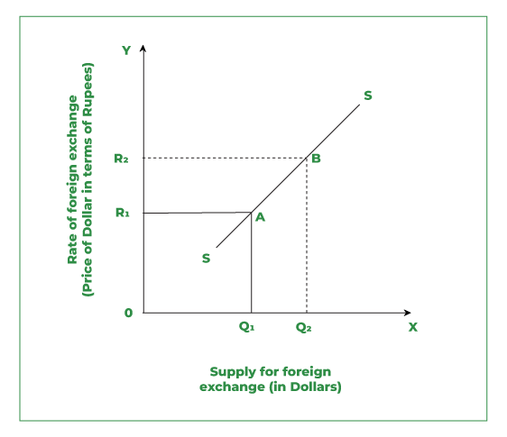
Supply of Foreign Exchange
Notes:
Supply of Foreign Exchange
The supply of foreign exchange involves receipts of foreign exchange. Thus it indicates the inflow of foreign currency into the domestic country. The major sources of supply of foreign exchange are stated below:
Exports: Whenever the foreigner purchases goods and services from a domestic country (India), the payment is made by the foreigner in foreign exchange. Thus, in the case of Exports of goods and services, there is an increase in the supply of foreign exchange in India’s foreign exchange market.
One-sided/Unilateral Transfers from Abroad: These are the transfers made by the person for free. It includes the transfer of gifts and grants sent by the government or a person to other countries. These are called unilateral transfers because these are not made to get something in return. Thus for unilateral transfers, foreign exchange is required. If Indians are working in a foreign country. It means they earn income abroad. When they send back the income earned to their homeland for their families in India, it results in an increase in the supply of foreign exchange in India’s foreign exchange market.
Tourism: To pay for expenses incurred during international tours, tourists require foreign exchange. If foreign tourists come to India, then they need our Indian Rupee for their stay. They supply foreign exchange in return for the Indian Rupee which will in return increase the supply of foreign exchange in India.
Foreign Direct Investments(FDI) in India: FDI refers to the investment made to get direct control of the domestic market. When investments are made by Multinational Companies (like Pizza Hut, and Dominos). In India, there is a flow of foreign exchange.
Foreign Portfolio Investments(FPI) by Foreign Investors: FPI refers to the investment made to earn profit in the domestic market. These are made in form of shares, debentures, bonds, etc. Any purchase in the Indian stock exchange by foreign investors results in the flow of foreign exchange in the Indian share market.
Deposits by Non-Resident Indians(NRI): Foreign exchange flows in the Indian foreign exchange market due to deposits by Non-Resident Indians(NRI) in India.
Speculation: Supply of foreign exchange arises when people earn money from the foreign exchange by speculating.
Reasons for Rising Supply of Foreign Currency
The supply of foreign currency rises in the following situations:
1. The supply of foreign currency rises because of the depreciation of domestic currency (it can also be said that there is an appreciation in the price of foreign currency). Depreciation of the domestic currency refers to the decrease in the value of the domestic currency in comparison to foreign currency. For example, if the price of $1 (US Dollar) rises from ₹60 to ₹64, then it means that more goods will be purchased in rupees with the same dollar. This indicates that exports to the USA will increase, as Indian goods become cheaper in the USA. It will ultimately increase the supply of US Dollars in India.
2. When the price of foreign currency increases, the tendency for speculative gains in the domestic country rises. Thus it increases the supply of foreign exchange.
3. A rise in the exchange rate of $1= ₹60 to $1= ₹64, increases the purchases by the non-resident in India.
4. Tourism in the domestic country increases as travelling in India has now become relatively cheaper.
5. There is an increase in the level of investment from a foreign country as the purchasing power of the foreign currency in the domestic country rises.
Supply Curve of foreign exchange
There is a positive relationship between the rate of foreign exchange and demand for foreign exchange. This means the higher the rate of foreign exchange, the higher will be the supply of foreign exchange and vice-versa. Thus supply curve slopes upwards. The relationship between the rate of foreign exchange and the quantity supplied of foreign exchange can be illustrated graphically with the help of an upward-sloping curve as shown in Figure .
In the graph, the exchange rate is shown on the Y axis, and the supply of foreign exchange is shown on the X axis. The supply curve SS shows the direct (positive) relation between the rate of exchange rate and the supply of foreign exchange. The supply curve (positive sloping) shows that when the rate of foreign exchange rises from OR₁ to OR₂, then the supply of foreign exchange rises from OQ₁ to OQ₂.

Slide 21
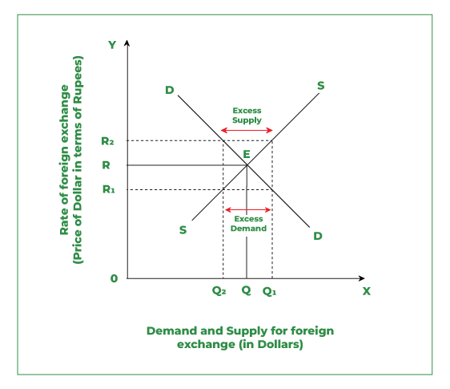
Determination of Foreign Exchange Rate
Notes:
The flexible exchange rate is determined by the forces of demand and supply of foreign exchange in the market. Under this, the equilibrium is established at a point where the quantity demanded is equal to the quantity supplied of foreign exchange, i.e., Demand for foreign exchange is similar to the supply of foreign exchange. This can be shown in the above figure.
Observations:
It is evident in the diagram that the rate of foreign exchange is shown on the Y axis, and the demand and supply of foreign exchange are shown on the X axis.
DD is a negatively sloped Demand curve, and SS is a positively sloped Supply curve of foreign exchange that intersects each other at point E.
Point E shows the equilibrium between the demand and supply of foreign exchange.
Point E corresponds to the OR, which is the equilibrium rate of exchange and OQ, which is the quantity of foreign exchange demanded and supplied.
But now the question arises what if the exchange rate is not the Equilibrium exchange rate?
Case I: At the exchange rate higher than the equilibrium exchange rate, say OR₂, there will be excess supply, i.e., Q₁Q₂. This is so because there is a positive relationship between the price of foreign exchange and the quantity supplied. Thus if the exchange rate rises, the quantity supplied also increases. On the other hand, demand will fall to OQ₂, as there is a negative relationship between the price of foreign exchange and the quantity demanded. Thus the excess supply with the fall in demand for foreign exchange will push down the rate of foreign exchange (this indicates that the Indian Rupee will appreciate). It will again lead to an increase in demand from OQ₂ to OQ, and a decrease in supply from OQ₁ to OQ till it reaches equilibrium E.
Case II: Conversely, at the exchange rate lower than the equilibrium exchange rate says OR₁, there will be excess demand, i.e., Q₁Q₂. This is so because there is a negative relationship between the price of foreign exchange and the quantity demanded. Thus if the exchange rate falls, the quantity demanded increases. On the other hand, supply will fall to OQ₂, as there is a positive relationship between the price of foreign exchange and the quantity supplied. Thus the excess demand with an increase in the demand for foreign exchange will push up the rate of foreign exchange (this indicates that the Indian Rupee will depreciate). It will again lead to a decrease in demand from OQ₁ to OQ and an increase in supply from OQ₂ to OQ till it reaches equilibrium E.

Slide 22
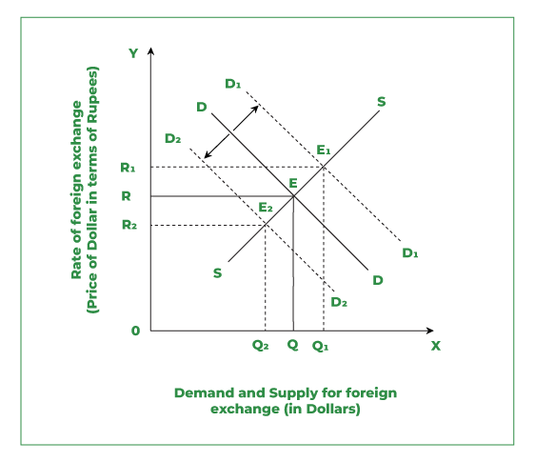
Determination of Exchange Rate due to Change in Demand
Notes:
The foreign exchange rate may rise or fall depending upon the changes in demand and supply of foreign exchange.
1. Change in Demand
Change in Demand may be either an “Increase in Demand” or a “Decrease in Demand“
Change in demand is demonstrated in the above figure. On the Y axis, the Rate of the exchange is shown and on the X axis, the Demand and Supply of foreign exchange are shown. DD is the demand curve and SS supply curve. Both curves (demand and supply) intersect each other at point E. Thus, E is the Equilibrium point. Equilibrium E corresponds to the OR Rate of foreign exchange rate and OQ quantity demanded.
Increase in Demand:
The increase in the demand for foreign exchange will shift the demand curve from DD to D₁D₁. It can be seen in Fig 2 that due to a shift in the demand curve, the supply curve will now meet the demand curve at E₁, which will be the new Equilibrium point. Now, at the new equilibrium point, the exchange rate will increase to OR₁ with quantity demanded as OQ_{1.} It means that with an increase in demand, the exchange rate will also increase.
Decrease in Demand:
The decrease in the demand for foreign exchange will shift the demand curve from DD TO D₂D₂. It can be seen in Fig 2 that due to a shift in the demand curve, the supply curve will now meet the demand curve at E₂, which will be the new Equilibrium point. Now, at the new equilibrium point, the exchange rate will decrease to OR₂ with quantity demanded as OQ_{2.} It means that with a decrease in demand, the exchange rate will also decrease.

Slide 23
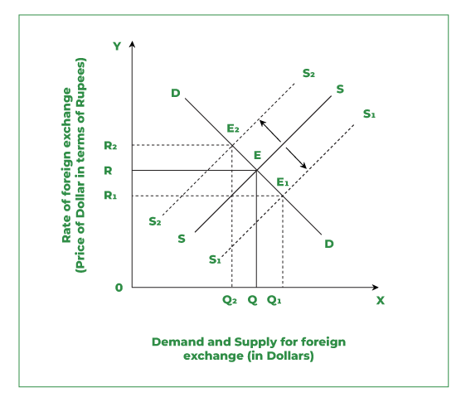
Determination of Exchange Rate due to Change in Supply
Notes:
Change in Supply may be either an “Increase in Supply” or a “Decrease in Supply“.
Change in supply is demonstrated in the above Figure. On the Y axis, the Rate of exchange is shown and on the X axis, the Demand and Supply of foreign exchange are shown. DD is the demand curve and SS supply curve. Both curves (demand and supply) intersect each other at point E. Thus E is the Equilibrium point. Equilibrium E corresponds to the OR Rate of foreign exchange rate and OQ quantity supplied.
1. Increase in Supply:
The increase in the supply of foreign exchange will shift the supply curve from SS to S₁S₁. It can be seen in Fig 3 that due to a shift in the supply curve, the demand curve will now meet the supply curve at E₁, which is the new Equilibrium point. Now, at the new equilibrium point, the exchange rate will decrease to OR₁ with quantity demanded as OQ_{1.}. It means that with an increase in supply, the exchange rate will decrease.
2. Decrease in Supply:
The decrease in the supply of foreign exchange will shift the supply curve from SS to S₂S₂. It can be seen in Fig 3 that due to a shift in the supply curve, the demand curve will now meet the supply curve at E₂, which is the new Equilibrium point. Now, at the new equilibrium point, the exchange rate will increase to OR₂ with quantity demanded as OQ_{2.} It means that with a decrease in supply, the exchange rate will increase.

Slide 24
Foreign Exchange Market
The foreign exchange market is an over-the-counter (OTC) marketplace that determines the exchange rate for global currencies.
It is, by far, the largest financial market in the world and is made up of a global network of financial centers that transact 24 hours a day, closing only on the weekends.
Currencies are always traded in pairs, so the "value" of one of the currencies in that pair is relative to the value of the other.
Notes:
What is Foreign Exchange Market?
Every nation has a unique currency that it uses for commerce and business, in India, it’s Indian Rupee, but what about the global market? The lack of flexibility of the currencies makes them a barrier to international trade. The Foreign Exchange Market was formed to solve this problem. This is a specific kind of market where the currency exchange rates are fixed. In absence of a foreign exchange market, the global economy would suffer greatly. The Foreign Exchange Market is the market in which the national currencies are traded for one another.
It refers to the market for national currencies of different countries in the world. It is the center of trade for the different currencies.
In simple words, it is a market in which buying and selling of foreign currencies take place. In this market buyers and sellers constitute people who wish to buy or sell foreign exchange. The buyers can be individuals, firms, commercial banks (like the State Bank of India), the central bank( Reserve Bank of India), commercial companies, and investment brokers.
Sometimes there is a confusion that the foreign exchange market is a physical place where we can go and trade the currencies of different countries. But, the foreign exchange market is not confined to a place, it is a system. Moreover, there are a large number of foreign currencies like the Dollar, Pound, Yen, and many others, which can be traded, converted, and exchanged in this market and not restricted to one or few foreign currencies. The exchange rate for all currencies is decided on the foreign exchange market, which is a global market. Currency Market or Forex are other names for the foreign exchange market. The players in this market can exchange, buy, sell, and speculate on the currencies.

Slide 25
Types of Exchange Rate Regime
Fixed Exchange Rate
In a fixed exchange rate system, the value of a country's currency is set or pegged to the value of another currency or a basket of currencies. Central banks or governments actively intervene in the foreign exchange market to maintain the fixed rate.
2. Floating Exchange Rate
In a floating exchange rate system, the value of a country's currency is determined by market forces of supply and demand in the foreign exchange market. Central banks or governments do not intervene to set or maintain exchange rates.
3. Managed Floating Exchange Rate
A managed float system combines elements of both fixed and floating exchange rate systems. While exchange rates are primarily determined by market forces, central banks or governments may intervene occasionally to influence the currency's value.
Notes:
Fixed Exchange Rate System:
Explanation: In a fixed exchange rate system, the value of the Indian Rupee (INR) is set or pegged to the US Dollar (USD) at a predetermined rate. The Reserve Bank of India (RBI) actively intervenes in the foreign exchange market to maintain this fixed rate.
Example: Suppose India decides to fix the exchange rate of the Indian Rupee (INR) to the US Dollar (USD) at 1 USD = 75 INR. The RBI would intervene in the foreign exchange market by buying or selling INR to maintain this fixed rate.
Pros:
Provides stability for businesses engaged in international trade.
Helps control inflation by limiting currency fluctuations.
Cons:
Requires constant intervention by the RBI to maintain the fixed rate.
May lead to misalignment of exchange rates with economic fundamentals.
Floating Exchange Rate System:
Explanation: In a floating exchange rate system, the value of the Indian Rupee (INR) is determined by market forces of supply and demand in the foreign exchange market. The RBI does not intervene to set or maintain exchange rates.
Example: Suppose India adopts a floating exchange rate system. The value of the Indian Rupee (INR) relative to the US Dollar (USD) fluctuates freely based on market demand and supply.
Pros:
Allows for automatic adjustment to changes in economic conditions.
Reduces the need for RBI intervention and provides flexibility in monetary policy.
Cons:
Can lead to exchange rate volatility, creating uncertainty for businesses and investors.
May result in speculative attacks or currency crises during periods of extreme volatility.
Managed Float System:
Explanation: In a managed float system, the RBI allows the exchange rate of the Indian Rupee (INR) to primarily be determined by market forces, but it may intervene occasionally to influence the currency's value.
Example: Suppose India operates under a managed float system. The RBI may occasionally intervene in the foreign exchange market to stabilize the exchange rate or address excessive volatility.
Pros:
Allows for some degree of exchange rate flexibility while still providing stability through occasional intervention.
Provides the RBI with the flexibility to manage exchange rates to achieve economic objectives.
Cons:
Requires careful management by the RBI to avoid disrupting market confidence or exacerbating volatility.
May lead to uncertainty about the extent and timing of RBI interventions.
These examples illustrate how different exchange rate systems can impact the value of the Indian Rupee (INR) relative to the US Dollar (USD) and the factors influencing exchange rate movements. The choice of exchange rate system depends on India's economic goals, level of integration with global markets, and ability to manage exchange rate fluctuations.

Slide 26
Devaluation vs Depreciation
Devaluation: Devaluation of a currency is a deliberate lowering of an official exchange rate of a country and setting a new fixed rate with respect to a reference of foreign currency such as the USD.
Depreciation: The decrease in the currency value as compared to other major currency benchmarks due to market forces. The process of devaluation tends to render the foreign currency more expensive than the local currency.
Notes:
DEVALUATION
Sometimes there arise some situations when the value of the domestic currency tends to increase drastically and faces monetary barriers. The government and the central bank intervene with some effective monetary policies for the correction of exchange rates, trade deficits, etc. One of these practices is the Devaluation of Currency. Devaluation of Currency is a monetary policy tool practiced by the government of a country in order to adjust the prevailing exchange rate.
What is Devaluation of Currency?
Devaluation of Currency is a monetary policy tool practised by the government of a country in order to adjust the prevailing exchange rate. Currency devaluation is mostly practised in cases of fixed or semi-fixed currencies, in developing countries. Reduction of trade deficit and/or debts, encouraging exports, and discouraging imports are the essence of currency devaluation. The government of the country deliberately reduces the value of its currency in order to adjust the non-desirable exchange rate. Devaluation of Currency is also known as Forced Downward of Currency and Deliberate Devaluation Tactic. Currency Devaluation sets a new and revised exchange rate for currency. Usually, the Central Bank of the country performs this practice because Central Bank is responsible for buying and selling of foreign exchange.
It is a deliberate practice performed by the government of a country in order to adjust the prevailing foreign exchange rate and boost the economy. However, it does not remain deliberate when the country is unable to handle the situation, in that case, this practice gets imposed on the country.
It is a practice of forced downward of the value of the currency to make the exchange rate favourable for the domestic economy.
Reasons for Devaluation of Currency
1. Exports Encouragement: Every country wants its product to be more competitive in the international market and devaluation of currency helps them do so. In case, the currency gains value, exports will be costly, creating a negative impact on demand and not be so much of a help to the home country.
2. Reduction of Debt Burden: Currency Devaluation makes the repayment of debts easy. As the currency becomes weak, it makes the payment of instalments less expensive.
3. Narrowing the Trade Deficit: A negative trade balance can affect the country’s economy adversely and can lead to borrowing. Thus, currency devaluation can encourage exports which will help the trade balance to reduce, and/or cut down its deficit balance.
Trade Balance = Exports – Imports
Effects of Currency Devaluation
Currency Devaluation has many impacts on the economy of the country on a micro as well as macro level. Some of the effects of currency devaluation are as follows:
1. There as many negative impacts of currency devaluation like inflation, rise in general prices, loss of foreign investment, etc. Currency Devaluation can crush the confidence of the investors and they will be forced to withdraw their money.
2. Currency Devaluation can cause currency wars among countries. As the country devaluates itself, exports will rise, and as a result, demand will increase. When the other companies will notice such positive impacts of currency devaluation, they will also be tempted to devalue their currency, leading to a currency war.
3. When loans are priced in the home currency, and the host currency devaluates its value, it will lead to a loan burden on the shoulders of the host country. Such a situation may form a negative image of the country.
Critical Evaluation of Devaluation of Currency
Advantages of Currency Devaluation:
Currency Devaluation encourages exports and can further help the company acquire a significant market share in the foreign market. A healthy export level leads to the inflow of foreign exchange in the domestic country.
Currency Devaluation makes the country more competitive in the foreign market.
Currency Devaluation makes the repayment of debts cheaper. As the value of domestic currency becomes weak, it makes the payment less expensive.
Currency Devaluation helps the country in maintaining a healthy balance of trade and overcome the trade deficit, if any.
Disadvantages of Currency Devaluation:
Currency Devaluation creates a negative image of the country’s economy in the mind of foreign investors. It can adversely affect Foreign Direct Investment (FDI) and Foreign Portfolio Investment (FPI).
Foreign tourism can also get affected as the currency devaluates. Foreign travel and buying activity in the foreign country will be costly.
When loans are priced in the home currency, and the host currency devaluates its value, it will lead to a loan burden on the shoulders of the host country. Such a situation may form a negative image of the country.
What is Depreciation of Currency?
Currency Depreciation refers to a decrease in the value of a currency as compared to other currencies in a floating exchange rate system. Market forces of demand and supply work towards the depreciation of the currency and determine a currency depreciation rate. The country’s trade exports and trade imports play an important role in determining the currency depreciation rate. The value of a currency is basically determined by its economic conditions along with exports and imports. It affects other economic decisions and the financial market.
Currency depreciation refers to a decline in the value of a currency as compared to other currencies, only in a floating exchange rate system, not in a fixed exchange rate system.
Factors leading to currency depreciation include political instability, trade exports and imports, other macroeconomic variables, etc.
Currency depreciation generally occurs when there is a significant increase in imports of a country, affecting the domestic balance outflow. A situation of inflation arises in the home country donating higher interest rates.
Reasons for Depreciation of Currency
Currency depreciation occurs due to various prevailing factors including changes in interest rates, political instability, and various other economic factors. Some of the most important market factors that lead to currency depreciation are:
Speculation of Currency in the Market
Central Bank Intervention
Reduced Interest Rates
Downfall in Country’s Exports
Example of Depreciation of Currency
There are two countries, out of which one country has currency A and the other country has currency B. One unit of A was equal to four units of B. However, due to certain industrial setbacks and other political events in the country having currency A, the exchange rate for its currency got affected. Therefore, for one unit of currency A, an individual gets 3.6 units of B. Can this shift be related to the depreciation of currency?
Initially 1 unit of A = 4 units of B or A/B = 4.
Later on, after the change in the value of the currency 1 unit of A = 3.6 units of B or A/B = 3.6
Only 3.6 B is paid now; however, 4 B was paid earlier for every unit of A. Therefore, currency A has depreciated, and currency B has strengthened.
Depreciation% = (4-3.6)/4 = 10%
Effects of Depreciation of Currency
Currency depreciation affects the economy of a country in general as well as individual variables like trade imports, trade exports, interest rates, etc. Some of the effects of currency depreciation involve:
1. As currency depreciation leads to higher interest rates, the debt instruments may become cheaper. But if the currency depreciation is happening due to some other factors, other than inflation, debt instruments may not get affected at all.
2. Due to currency depreciation, the interest rates may face a significant increase. In that case, the government will try to control the interest rates by imposing curbs on them, hence balancing the economy.
3. Currency depreciation will lead to more imports than exports, creating an imbalance in the balance of payment accounts. Thus, the country will need to correct the disequilibrium of the balance of payment account.
Critical Evaluation of Depreciation of Currency
Advantages of Currency Depreciation:
Currency depreciation can cause a rise in exports inviting a large foreign exchange in the country. A rise in exports will balance the trade deficit due to which currency depreciated in the first place.
Currency depreciation overall acts as a measure to correct the economy.
Disadvantages of Currency Depreciation:
Currency depreciation leads to an overall rise in the general prices of the products in the home economy, which in turn will lead to inflation. Currency depreciation arises due to more imports.
Investments in financial instruments become more expensive as the value of currency depreciates.
As currency depreciation affects the economy as a whole, it also affects employment, financial markets, foreign direct investments, balance of trade, etc.
All the currencies in the international market have some particular exchange rate. If there arises any depreciation of the currency, it will impact the overall performance of the currency in the international market.

Slide 27
Revaluation vs Appreciation
Revaluation refers to an increase in the value of a country's currency relative to other currencies in a fixed exchange rate system or in a managed float system where authorities intervene to influence exchange rates.
Appreciation refers to an increase in the value of a country's currency relative to other currencies in the foreign exchange market. It means that the currency can buy more of other currencies, or that other currencies can buy fewer units of the appreciating currency.
Notes:
Currency Revaluation
Revaluation is a significant rise in a county’s official exchange rates in relation to a foreign currency. The process of revaluation can only be done by the central bank of the revaluing country.
For instance, if a countries currency trades at 10 units to 1 US dollar, to revalue it, the said country can change to using 5 units of its currency to be equivalent to 1 dollar in order to make it twice expensive compared to the dollar.
Causes Of Currency Revaluation
Changes in interest rates of various countries could cause a country to resort to currency revaluation so as to maintain its profitability and economic competitiveness.
Countries can also revalue their currency for speculative purposes. For instance, prior to the 2016 Brexit by Britain, a lot of other countries’ currencies fluctuated because of speculative reasons and need to remain profitable despite any outcome of the vote.
International Monetary Fund
The issue of currency revaluation and devaluation led to the establishment of the International Monetary Fund (IMF), a body that regulates the frequent devaluation and revaluation that are used by different countries to unfairly gain a competitive advantage over others. The IMF has also given each member a right to choose an exchange rate to use. These policies have helped the ill-advised motives of devaluation and revaluation.
Fixed Exchange Rate System: In a fixed exchange rate system, where the value of a currency is pegged to another currency or a basket of currencies, revaluation occurs when the authorities responsible for maintaining the fixed rate decide to increase the value of their currency relative to the anchor currency. This is typically done by adjusting the official exchange rate upward.
Managed Float System: In a managed float system, where exchange rates are determined by market forces but authorities intervene occasionally to influence the currency's value, revaluation can occur when policymakers actively buy or sell their currency in the foreign exchange market to push its value higher.
Reasons for revaluation may include:
Correcting Undervaluation: If a country's currency is perceived to be undervalued relative to its true value based on economic fundamentals, authorities may revalue the currency to bring it closer to its equilibrium level.
Addressing Trade Imbalances: Revaluation can help reduce trade imbalances by making imports cheaper and exports more expensive, thereby encouraging domestic consumption of domestic goods and reducing reliance on imports.
Fighting Inflation: Revaluation can help combat inflation by reducing the cost of imported goods and services, which may lead to lower domestic prices and inflationary pressures.
However, revaluation can also have drawbacks:
Export Competitiveness: A revaluation can make a country's exports more expensive for fore

Slide 28
Review Question
Question: the increase in the value of domestic currency in relation to the foreign currency due to fluctuations in foreign exchange rate is called
Depreciation
Devaluation
Appreciation
Revaluation

Slide 29
Review Question
Question: Which of the following is correct?
Depreciation in value of the currency is caused because of the fluctuation in the demand and supply.
Devaluation in domestic currency is done intentionally by the government.
Appreciation is done intentionally by the government.
Both a and b

Slide 30
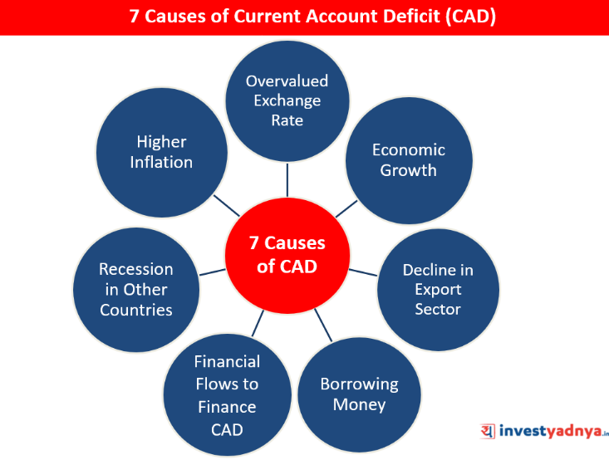
Current Account Deficit
Notes:
Causes of Current Account Deficit
1.Overvalued Exchange Rate
If the currency is overvalued, imports will be cheaper, and therefore there will be a higher quantity of imports.
Exports will become uncompetitive, and therefore there will be a fall in the quantity of exports.
2. Economic Growth
If there is an increase in national income, people will tend to have more disposable income to consume goods. If domestic producers cannot meet the domestic demand, consumers will have to import goods from abroad.
Therefore if there is fast economic growth there tends to be a significant increase in the quantity of imports and a deterioration in the current account.
3. Decline in Competitiveness/Export Sector
There might be a decline in the competitiveness/export sector in a country because it has to struggle to compete with the other developing countries. This has led to a persistent deficit in the balance of trade.
4. Higher Inflation
If India’s inflation rises faster than our main competitors then it will make India’s exports less competitive and imports more competitive.
This will lead to deterioration in the current account. However, inflation may also lead to a depreciation in the currency to offset this decline in competitiveness.
5. Recession in other countries
If India’s main trading partners experience negative economic growth, then they will buy less of our exports, worsening the India’s current account.
6. Borrowing Money
If countries are borrowing money to invest e.g. third world countries, then this will lead to deterioration in current account position.
7. Financial Flows to Finance Current Account Deficit
If a country can attract more financial flows (either short-term portfolio investment or long-term direct investment), then these flows on the financial account will enable the country to run a larger current account deficit.
For example, the India has run a persistent current account deficit since 2005; this reflects the fact the India has attracted capital flows to finance this current account deficit. Without financial flows, the currency would depreciate until equilibrium is restored.

Slide 31
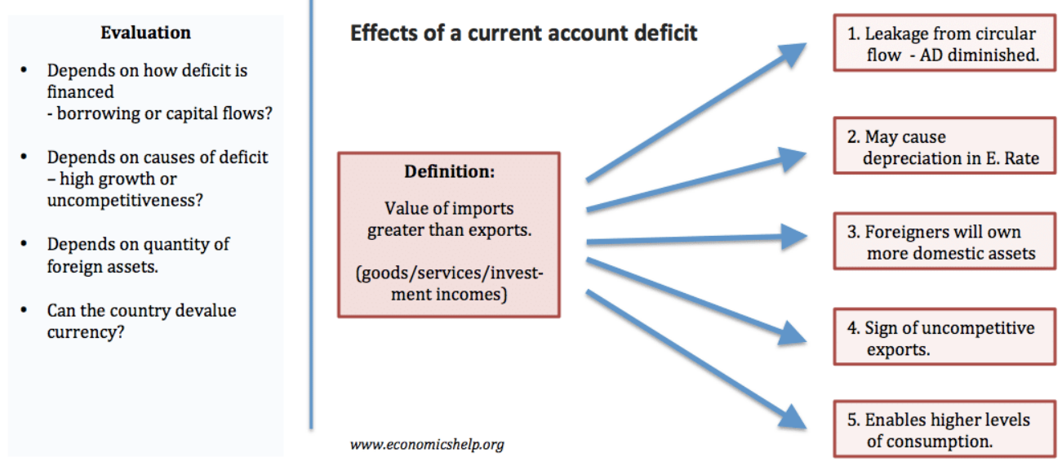
Current Account Deficit
Notes:
Current account deficit
Imports greater than exports, so expenditure is leaving the economy to buy imports.
Current account deficit may cause depreciation as there is greater demand for imports and foreign currency.
A current account deficit is financed by attracting capital inflows, e.g. foreigners buying domestic assets. This means foreigners hold a greater claim on assets and dividends. (Could also make country vulnerable to capital flight)
A current account deficit may be a sign the economy is uncompetitive. Consumers prefer to buy cheaper imports than domestic goods.
The benefit of a current account deficit is that it allows higher levels of domestic consumption than otherwise possible because we are buying from abroad.
Evaluation
A deficit financed by long-term capital investment is more sustainable than a deficit financed by borrowing.
A deficit may occur due to high growth and strong consumer spending – rather than uncompetitiveness.
Some countries like US and UK run current account deficits, but they have many foreign assets.
Other countries like Russia and Venezuela have experienced a balance of payments crisis because they have been adversely affected by a fall in the price of oil which damages export revenue very quickly and developing countries more vulnerable to international investors withdrawing.
A devaluation in the exchange rate could restore competitiveness and improve current account. But, would devaluation hurt or help the economy?
Problems associated with a current account deficit
The exchange rate could fall – causing inflationary pressures. This is more of a problem when a country follows some kind of exchange rate target, e.g. the UK in 1976 crisis.
A deficit financed by financial flows could be vulnerable to capital flight if foreign investors decide to sell assets and return the money. This is a problem for developing economies who become seen as a risky place to invest.
In the Euro, large current account deficits of Spain, Greece and Portugal were a sign of an uncompetitive economy. In the Euro, they couldn’t devalue to restore competitiveness leading to lower economic growth because of depressed export demand.
With current account deficit, foreigners have an increased claim on domestic assets.
However, other economists suggest that concerns over current account deficits are misplaced – so long as the deficit is ‘manageable’ and financed by sustainable capital flows.
UK and US have run persistent current account deficits for long periods without any adverse impact.
Current account deficits financed by capital flows mean the country is attracting Foreign Direct Investment (FDI) – which is increasing domestic productive capacity.
More detail on – Should we worry about a current account deficit?
How to reduce a current account deficit?
There are three main policies:
Devalue the exchange rate – cheaper exports and more expensive imports should improve the current account.
This assumes demand for exports and imports is relatively price elastic. See: effects of devaluation in exchange rate
Reduce consumer spending – Tight fiscal/monetary policy will lead to a slowdown in consumer spending – reducing imports and improving the current account. Export demand will be unaffected by domestic monetary policy. Also, lower domestic demand should reduce inflation. Lower inflation should improve the competitiveness of exports
But, this will conflict with objectives of higher economic growth.
Supply-side policies – in the long term, efforts to improve productivity can improve the competitiveness of exports.
More detail on – how to reduce a current account deficit.
Trade deficit
A trade deficit refers to just the balance of trade on visible goods. This trade deficit is a component of the current account. The UK has often run a deficit on the trade account, but run a surplus on services.
Effects / Consequences of CURRENT ACCOUNT DEFICIT
Economic growth : In the short-run, a current account deficit is helpful to the debtor nation. Foreigners are willing to pump capital into it. That drives economic growth beyond what then country could manage on its own.
Weakening of demand : In the long run, a current account deficit saps economic vitality. Foreign investors question whether economic growth will provide enough return on their investment. Demand weakens for the country’s assets, including the country’s government bonds.
Rise in bond yields : As foreign investors withdraw funds, bond yields rise. The national currency loses value relative to other currencies. That lowers the value of the assets in the foreign investors’ strengthening currency. It further depresses investor demand for the country’s assets. This can lead to a tipping point where investors will dump the assets at any price.
Rise in value of foreign assets : The only saving grace is that the country’s holdings of foreign assets are denominated in foreign currency. As the value of its currency declines, the value of the foreign assets rise. That further reduces the current account deficit.
Setting in of Inflation : In addition, a lower currency value increases exports as they become more competitively priced. The demand for imports falls once prices rise as inflation sets in. These trends stabilize any current account deficit.
Lower Standard of Living : Regardless of whether the current account deficit unwound via a disastrous currency crash or a slow, controlled decline, the consequences would be the same. That’s a lower standard of living for the country’s residents.

Slide 32
Capital Account
A capital account deficit occurs when a country's investments abroad exceed foreign investments in the country.
A capital account surplus occurs when a country receives more capital inflows than capital outflows in a specific period. In other words, it indicates that the country is attracting more foreign investment or receiving more funds from abroad than it is investing or sending abroad
Notes:
A capital account deficit occurs when a country's investments abroad exceed foreign investments in the country. Like a current account deficit, a capital account deficit can have both advantages and disadvantages. Here are some potential pros and cons:
Pros of Capital Account Deficit:
Access to Foreign Capital: A capital account deficit can signify that a country is attracting significant foreign investment. This influx of foreign capital can be beneficial for financing domestic investments, stimulating economic growth, and improving infrastructure.
Diversification of Investment Portfolio: A capital account deficit may indicate that domestic investors are diversifying their investment portfolios by investing abroad. This diversification can help reduce risk by spreading investments across different countries and asset classes.
Access to Technology and Expertise: Investments made abroad as part of a capital account deficit can provide access to new technologies, management practices, and expertise. This can facilitate knowledge transfer and innovation, contributing to long-term economic development.
Cons of Capital Account Deficit:
Debt and Financial Vulnerability: A persistent capital account deficit may lead to a buildup of external debt. Excessive reliance on foreign capital inflows to finance investments can increase a country's vulnerability to external shocks and fluctuations in global financial markets. If foreign investors lose confidence or decide to withdraw their investments, it can lead to financial instability and currency depreciation.
Crowding Out Domestic Investment: A capital account deficit can sometimes crowd out domestic investment by diverting resources towards servicing external debt or meeting the demands of foreign investors. This can reduce the availability of funds for domestic businesses and infrastructure projects, potentially hindering long-term economic growth.
Loss of Control Over Strategic Assets: Investments made abroad as part of a capital account deficit may involve the acquisition of strategic assets by foreign entities. This could lead to concerns about loss of control over key industries, national security risks, and potential negative impacts on employment and economic sovereignty.
Example:
Suppose Country X consistently runs a capital account deficit due to its large-scale investments in foreign markets. Foreign investors are attracted to Country X's dynamic economy and abundant investment opportunities. As a result, Country X receives significant inflows of foreign capital, which are used to finance infrastructure projects, technological advancements, and acquisitions abroad.
Pros:
Access to foreign capital stimulates economic growth and development.
Investments abroad provide access to new technologies and expertise.
Cons:
Increased reliance on external financing raises the risk of debt and financial vulnerability.
Domestic investment may be crowded out, limiting resources for domestic projects.
Loss of control over strategic assets and potential national security concerns.
In summary, while a capital account deficit can bring benefits such as access to foreign capital and diversification of investment portfolios, it also poses risks such as debt accumulation, crowding out of domestic investment, and loss of control over strategic assets. Therefore, policymakers must carefully monitor and manage capital flows to ensure they support sustainable economic growth and stability.
Access to Foreign Investment: A capital account deficit can signify that a country is attracting significant foreign investment. This influx of foreign capital can be beneficial for financing domestic investments, stimulating economic growth, and improving infrastructure.
Diversification of Investment Portfolio: A capital account deficit may indicate that domestic investors are diversifying their investment portfolios by investing abroad. This diversification can help reduce risk by spreading investments across different countries and asset classes.
Access to Technology and Expertise: Investments made abroad as part of a capital account deficit can provide access to new technologies, management practices, and expertise. This can facilitate knowledge transfer and innovation, contributing to long-term economic development.
Cons of Capital Account Deficit:
Debt and Financial Vulnerability: A persistent capital account deficit may lead to a buildup of external debt. Excessive reliance on foreign capital inflows to finance investments can increase a country's vulnerability to external shocks and fluctuations in global financial markets. If foreign investors lose confidence or decide to withdraw their investments, it can lead to financial instability and currency depreciation.
Crowding Out Domestic Investment: A capital account deficit can sometimes crowd out domestic investment by diverting resources towards servicing external debt or meeting the demands of foreign investors. This can reduce the availability of funds for domestic businesses and infrastructure projects, potentially hindering long-term economic growth.
Loss of Control Over Strategic Assets: Investments made abroad as part of a capital account deficit may involve the acquisition of strategic assets by foreign entities. This could lead to concerns about loss of control over key industries, national security risks, and potential negative impacts on employment and economic sovereignty.
Example:
Let's consider an example of a country, Country A, experiencing a capital account deficit:
Pros:
Country A attracts significant foreign investment from multinational corporations (MNCs) and institutional investors due to its stable political environment and growing economy.
These foreign investments are used to finance infrastructure projects, technological advancements, and acquisitions in various sectors, contributing to economic growth and job creation.
Cons:
The influx of foreign capital leads to a buildup of external debt for Country A, raising concerns about its financial vulnerability in case of global economic downturns or sudden changes in investor sentiment.
Domestic businesses in Country A may face challenges accessing financing, as resources are diverted towards servicing external debt and meeting the demands of foreign investors.
There are concerns about potential loss of control over strategic assets and industries, as foreign investors acquire significant stakes in key sectors of Country A's economy.
In summary, while a capital account deficit can bring benefits such as access to foreign investment and technology, it also poses risks such as debt accumulation, crowding out of domestic investment, and loss of control over strategic assets. Therefore, policymakers must carefully monitor and manage capital flows to ensure they support sustainable economic growth and stability.

Slide 33
Effect of Depreciation/ Devaluation
Pros of Depreciation
1.Boost to Exporters
2. Economic Stimulus
Cons of Depreciation
Increase in the price of Imports
Decline in Purchasing Power
Increase in External Debt
Notes:
Pros of Currency Depreciation:
Boost to Exporters: When a country's currency depreciates, its exports become cheaper for foreign buyers. This can boost demand for domestically produced goods and services in international markets, leading to increased export revenues. For example, let's consider a fictional country called "Econland" that produces cars. If Econland's currency depreciates against its trading partners' currencies, the price of its cars in foreign markets will decrease, making them more competitive and potentially increasing export sales.
Economic Stimulus: Currency depreciation can stimulate economic growth by encouraging domestic consumption and investment. Cheaper imports can lead to increased consumer spending as imported goods become more affordable. Additionally, depreciation can make domestic assets relatively more attractive to foreign investors, leading to capital inflows and investment in the domestic economy.
Cons of Currency Depreciation:
Import Price Increase: A major drawback of currency depreciation is that it leads to higher import prices. When a currency depreciates, the cost of imported goods and raw materials increases, which can contribute to inflationary pressures. For example, if Econland's currency depreciates, the cost of importing raw materials for car production will increase, potentially leading to higher production costs and consumer prices.
Purchasing Power Decline: Currency depreciation can erode the purchasing power of consumers and businesses. As imported goods become more expensive, consumers may experience a decline in their real incomes, leading to reduced standards of living. Businesses that rely on imported inputs may also face higher production costs, potentially leading to lower profitability and reduced investment.
External Debt Burden: Countries that have borrowed in foreign currencies may face increased debt servicing costs when their domestic currency depreciates. This is because the amount of domestic currency needed to repay foreign-denominated debt increases with depreciation, potentially straining government finances and contributing to fiscal challenges. For example, if Econland has borrowed in US dollars and its currency depreciates, it will need to use more of its own currency to repay the same amount of debt, increasing the burden on its budget.
In summary, while currency depreciation can have benefits such as boosting exports and stimulating economic growth, it also has drawbacks such as higher import prices, reduced purchasing power, and increased debt servicing costs. The overall impact of currency depreciation depends on various factors such as the structure of the economy, government policies, and external economic conditions.

Slide 34
Effect of Appreciation/ Revaluation
Pros of Appreciation
Lower Import Prices
Fighting Inflation
Cons of Appreciation
1.Reduced Export Competitiveness
2. Impact on trade Balance
3. Challenges for Export dependent Countries
Notes:
Pros of Currency Appreciation:
Cheaper Imports: When a country's currency appreciates, it becomes stronger relative to other currencies. This means that imports become cheaper for domestic consumers and businesses. For example, suppose Country A's currency appreciates against Country B's currency. As a result, imported goods from Country B become less expensive for consumers in Country A. This can lead to lower costs for businesses that rely on imported inputs, contributing to lower production costs and potentially lower consumer prices.
Lower Inflation: Cheaper imports due to currency appreciation can help mitigate inflationary pressures in the domestic economy. When imported goods are cheaper, businesses may choose to pass on these cost savings to consumers in the form of lower prices. This can help keep inflation in check and improve consumers' purchasing power.
Cons of Currency Appreciation:
Export Competitiveness: Currency appreciation can make a country's exports more expensive for foreign buyers. For example, suppose Country A's currency appreciates against Country B's currency. Goods produced in Country A become more expensive for consumers in Country B, leading to a decrease in demand for Country A's exports. This can negatively impact export-dependent industries such as manufacturing, agriculture, and tourism, leading to lower export revenues and potentially job losses.
Trade Balance: A decrease in export competitiveness due to currency appreciation can worsen a country's trade balance. If exports decrease while imports remain relatively inexpensive, the country may experience a trade deficit. This can lead to an outflow of domestic currency to pay for imports, putting downward pressure on the currency's value and potentially exacerbating the appreciation.
Example:
Let's illustrate these points with an example:
Currency Appreciation Example:
Suppose Country X experiences a currency appreciation against Country Y's currency. As a result:
Pros: Imports from Country Y become cheaper for consumers in Country X. For instance, if Country X imports electronics from Country Y, the appreciation of Country X's currency makes these electronics more affordable for consumers in Country X, leading to lower prices and potentially increased consumer purchasing power.
Cons: Country X's exports to Country Y become more expensive for consumers in Country Y. For example, if Country X exports automobiles to Country Y, the appreciation of Country X's currency makes these automobiles more expensive for consumers in Country Y, leading to a decrease in demand for Country X's exports and potentially lower export revenues.
In summary, while currency appreciation can benefit consumers through cheaper imports and lower inflation, it can also pose challenges for export competitiveness and trade balance, potentially affecting industries reliant on exports. As with any economic phenomenon, policymakers must carefully consider the implications and implement appropriate measures to manage the effects of currency appreciation

Slide 35
Inflation and Exchange Rate
Purchasing Power Parity (PPP)
Interest Rate Differentials
Trade Balance
Inflation Expectations
Notes:
Inflation can affect exchange rates through several channels, influencing the supply and demand dynamics of a country's currency in the foreign exchange market. Here's how inflation can impact exchange rates:
Purchasing Power Parity (PPP): According to the theory of Purchasing Power Parity, currencies tend to adjust in value over time to equalize the purchasing power of different currencies. Inflation erodes the purchasing power of a currency, causing its value to decrease relative to currencies with lower inflation rates. As a result, countries with higher inflation rates are likely to experience currency depreciation relative to countries with lower inflation rates.
Interest Rate Differentials: Central banks often adjust interest rates to control inflation. Higher inflation rates may prompt central banks to raise interest rates to curb inflationary pressures. Higher interest rates can attract foreign investors seeking higher returns on their investments. This increased demand for the country's currency can lead to currency appreciation. Conversely, lower inflation rates may prompt central banks to lower interest rates, leading to currency depreciation.
Trade Balance: Inflation can impact a country's trade balance, which, in turn, affects its currency's value. Higher inflation may lead to increased production costs, making a country's exports less competitive in international markets. This can result in a trade deficit, where a country imports more than it exports, putting downward pressure on its currency. Conversely, lower inflation may improve a country's export competitiveness, leading to a trade surplus and potential currency appreciation.
Inflation Expectations: Exchange rates are influenced by expectations of future inflation. If investors anticipate higher inflation in a country, they may demand a higher return to compensate for the erosion of purchasing power. This can lead to higher interest rates and currency depreciation. Conversely, if investors expect lower inflation, it can lead to lower interest rates and potential currency appreciation.
Relative Price Levels: Inflation affects relative price levels between countries, which can impact exchange rates. Countries with higher inflation rates typically experience higher price levels for goods and services compared to countries with lower inflation rates. As a result, their currencies may depreciate relative to currencies of countries with lower inflation rates to reflect the difference in price levels.
In summary, inflation can influence exchange rates through various channels, including purchasing power parity, interest rate differentials, trade balance, inflation expectations, and relative price levels. Understanding the relationship between inflation and exchange rates is essential for policymakers, investors, and businesses to make informed decisions in the global economy
Let's break down how inflation affects exchange rates using simple examples:
Example 1: High Inflation Country vs. Low Inflation Country
Suppose there are two countries: Country A and Country B.
Country A has a high inflation rate of 10% per year, while Country B has a low inflation rate of 2% per year.
Now, let's consider how inflation affects the exchange rate between their currencies.
In Country A, with high inflation, prices of goods and services are rising rapidly. As a result, the purchasing power of the currency decreases over time.
In Country B, with low inflation, prices are rising at a much slower pace, so the currency maintains its purchasing power better.
As a consequence of the difference in inflation rates:
Investors and traders in the foreign exchange market perceive the currency of Country A as less valuable compared to Country B's currency because its purchasing power is eroding faster.
To compensate for the loss in purchasing power, traders demand more units of Country A's currency for every unit of Country B's currency. This increases the exchange rate of Country A's currency relative to Country B's currency.
Example 2: Impact of Inflation on Import Prices
Consider a scenario where a country imports a significant portion of its goods, and inflation affects import prices.
Let's say Country C imports a lot of electronics from Country D.
If Country D experiences high inflation, the prices of electronics exported from Country D to Country C will increase.
As a result, Country C needs to pay more of its currency to buy the same amount of electronics from Country D.
To maintain the same level of imports, Country C needs to exchange more of its currency for Country D's currency, causing the exchange rate of Country C's currency to depreciate relative to Country D's currency.
These examples illustrate how inflation can impact exchange rates by affecting purchasing power, investor perceptions, and import prices. Inflation erodes the value of a currency over time, leading to depreciation relative to currencies with lower inflation rates. Understanding these dynamics helps explain how inflation influences exchange rate movements in the global economy

Slide 36
Review Question
Question: The decrease in the value of domestic currency in relation to foreign currency due to fluctuations in the foreign exchange rate is
a) Devaluation b) Appreciation c) Depreciation d) None of the above
Notes:
c

Slide 37
Review Question
Question: Due to depreciation of domestic currency,
a) Exports rise b) Imports rise c) Exports falls d) None of the above
Notes:
a

Slide 38
Review Question
Question: The increase in the value of domestic currency in relation to foreign currency due to fluctuations in foreign exchange rate is called
a) Depreciation b) Devaluation c) Appreciation d) Revaluation
Notes:
c

Slide 39
Review Question
Question: Which of the following is not correct in value of domestic currency
a) Devaluation is done by the Central Bank b) Revaluation is done by the market fluctuations of demand and supply c) Appreciation is caused due to change in demand and supply of foreign exchange d) None of the above
Notes:
b

Slide 40
Review Question
Question: Due to increase in demand of foreign currency, there is …. in the value of domestic currency.
a) Appreciation b) Depreciation c) Devaluation d) Revaluation
Notes:
Depreciation

Slide 41
Review Question
Question: The value of US Dollar $1 has increased form Rs. 60 to Rs. 70. It means:
a) Rupee has appreciated b) Rupee has depreciated c) Both (a) and (b) d) None of the above
Notes:
Rupee has depreciated

Slide 42
Review Question
Question: Due to decrease in demand of foreign currency, there is —- in the value of domestic currency.
a) Appreciation b) Depreciation c) Devaluation d) Revaluation
Notes:
Appreciation

Slide 43
Review Question
Question: Government has to hold huge reserves of foreign exchange to stabilize foreign exchange rate in the presence of_______ rate. ( Fill in the blank with the correct alternative).
a) Flexible exchange rate system b) Floating exchange rate system c) Fixed exchange rate system d) Managed floating exchange rate system

Slide 44
Review Question
Question: Demand of foreign exchange signifies_______.( Fill in the blank with correct alternative).
a) Inflow of foreign exchange b) Flow of foreign exchange c) No change in foreign exchange d) Outflow of foreign exchange
Notes:
Outflow of foreign exchange

Slide 45
Review Question
Question: Read the following statement given below and choose the correct alternative
Statement 1- If foreign exchange rate of a country increases, Demand of foreign exchange will also increase
Statement 2- If foreign exchange rate increases supply of foreign exchange will also increase
a) Both are correct b) Both are incorrect c) Statement 1 is correct and statement 2 is incorrect d) Statement 1 is incorrect and statement 2 is correct
Notes:
d

Slide 46
Review Question
Question: Read the following statement given below and choose the correct alternative
Statement 1- Depreciation is the fall in the value of domestic currency against foreign currency. Statement 2- Depreciation occurs under the floating exchange rate system.
a) Both are correct b) Both are incorrect c) Statement 1 is correct and statement 2 is incorrect d) Statement 1 is incorrect and statement 2 is correct
Notes:
b

Slide 47
Review Question
Question: Read the following statement given below and choose the correct alternative Statement 1- Revaluation leads to decrease in exports of a country. Statement 2- Revaluation leads to decrease in imports of a country
a) Both are correct b) Both are incorrect c) Statement 1 is correct and statement 2 is incorrect d) Statement 1 is incorrect and statement 2 is correct
Notes:
c

Slide 48
Review Question
Question: Exports and inflow of currency increased in an economy”. What can be the possible reason for this
a) Result of Revaluation b) Result of appreciation c) Both (a) and ( b) d) Result of depreciation
Notes:
d

Slide 49
Review Question
Question: Other things remaining unchanged, when in a country the price of foreign currency rises, national income is:
a) Likely to rise
b) Likely to fall
c) Likely to rise and fall both
d) Not affected
Notes:
a

Slide 50
Review Question
Question: When the RBI wants to strengthen the rupee, it __________________ foreign currency and __________domestic currency.
a) Buys, Sells
b) Sells, Sells
c) Sells, Buys
d) Buys, Buys
Notes:
c

